Slide 1
Leasing: What appears to be a cheaper alternative to an expensive car purchase

Slide 2
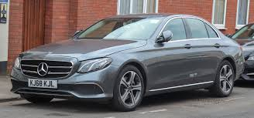
What is a Car Lease?
A Lease is a contract for you to rent a brand-new vehicle for a specified term: 24, 36, 39 months, etc.
Instead of purchasing the car, you will be paying the dealer monthly rent payments that cover the depreciation amount plus interest and fees
Leasing accounts for 26% of new-car transactions nationwide and 60% of transactions on Long Island!!!

Slide 3
Benefits of a Car Lease
Usually you will have a much lower monthly payment
This allows you to drive a much more expensive car than you could afford to purchase.
You get a brand new car every 2-4 years
You will probably have to pay for basic maintenance like tires/oil changes, but any severe issues are not your problem

Slide 4
Disadvantages of a Car Lease
Leasing is absolutely more expensive over the long run than buying
There are several fees that occur in a car lease that don’t exist in a purchase.
Acquisition fee
Disposition fee
Money Factor
You are paying the dealer for the car’s depreciation
You will also be paying the sales tax on that depreciation amount
There will likely be a mileage limit per year (fees if you go over)
Pay additional fees above any “normal” wear and tear
Insurance is more costly (gap insurance)
At the end of the lease period, you have to give the car back (no equity)

Slide 5


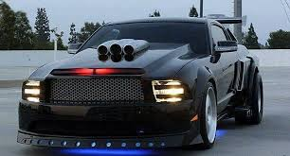
Disadvantages of a Car Lease (Continued)
9. And the worst possible disadvantage of a lease….
You are not allowed to modify your vehicle ☹

Slide 6
Why Do Car Dealers Like Leases?
Leasing is more profitable to a dealer
They basically get to sell the car twice!
All those extra fees are money in the bank for the dealer!
Acquisition fee: Ummm the car is already there!
Disposition fee: They will charge you to give the car back!
Money factor: You are paying for all of the car’s depreciation and then some!

